Slide 1
Flowchart
Photo by Pexels

Slide 2
1
Introduction
A flowchart is a graphical representation of a process or algorithm, consisting of various shapes connected by arrows to illustrate the sequence of steps. It's a powerful tool used in various fields such as software development, engineering, business management, and more. Here's an introduction to flowcharts along with their advantages:
Photo by Pexels

Slide 3
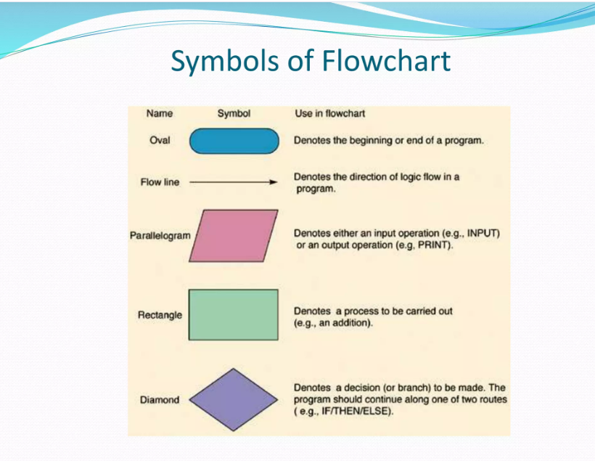
2
Symbols
Photo by Pexels

Slide 4
3
Advantages
Clarity and Understanding: Flowcharts provide a clear and concise representation of a process, making it easier for individuals to understand the steps involved and the sequence of operations.
Identification of Errors: By visually mapping out a process, flowcharts help in identifying errors, redundancies, or inefficiencies in the workflow. This allows for timely improvements and optimizations.
Documentation: Flowcharts serve as documentation for processes, procedures, and algorithms. They provide a visual reference that can be used for training purposes, auditing, or future revisions.
Communication: Flowcharts facilitate effective communication among team members, stakeholders, and project managers. They provide a common visual language that helps in conveying ideas, requirements, and expectations clearly.
Photo by Pexels

Slide 5
4
Pseudocode
Pseudocode is a high-level description of a computer programming algorithm that uses a combination of natural language and programming language-like syntax. It's not tied to any specific programming language and is often used as an intermediary step between problem-solving and actual coding. Here's an introduction to pseudocode along with some advantages:
Photo by Pexels

Slide 6
5
Contd..
Language Agnostic: Pseudocode is not tied to any specific programming language, allowing developers to focus on algorithm design and logic without getting bogged down in language syntax.
Readable and Understandable: Pseudocode is designed to be easily understandable by both technical and non-technical stakeholders. It uses simple language and structure to describe the steps of an algorithm clearly.
Step-by-Step Description: Pseudocode breaks down complex algorithms into step-by-step instructions, making it easier to visualize the flow of logic and understand the sequence of operations.
Debugging and Testing: Pseudocode can be used for early-stage debugging and testing of algorithms before actual implementation in a programming language. It allows developers to identify and resolve logic errors without the overhead of compiling and running code.
Photo by Pexels

Slide 7
6
Advantages
Flexibility: Pseudocode provides flexibility in algorithm design, allowing developers to focus on problem-solving without being constrained by the syntax or limitations of a specific programming language.
Clarity: Pseudocode promotes clarity and understanding by using natural language descriptions and simple syntax to convey the logic of an algorithm. This makes it easier for developers to communicate and collaborate on algorithm design.
Portability: Since pseudocode is language agnostic, algorithms described in pseudocode can be easily translated into any programming language. This allows developers to choose the most suitable language for implementation without having to rewrite the entire algorithm.
Photo by Pexels

